Slide 1
On Corpus Frequencies and the non-randomness problem
Stefan Evert
FAU Erlangen-Nürnberg
www.linguistik.fau.de

Slide 2
Frequency analysis in corpus linguistics
Standard methodology (McEnery & Wilson 2001, §3.4)
count frequencies in (sub)corpora to be compared
establish significance with chi-squared test (X²)
alternatively, likelihood-ratio test (G²) or Fisher's exact test
measure effect size (confidence interval based on X² normal approximation, e.g. with prop.test() in R)
Problems
invalid data pooling (Evert 2006; Gries 2006) leads to non-randomness (Kilgarriff 2005) – also known as “term clustering” in NLP (Katz 1996; Church 2000)
the notion of “corpus frequency” itself

Slide 3
Case study 1: Passive voice in English
joint research with Gerold Schneider (U Zürich)
Leech et al. (2009) study change in passive use in AmE and BrE based on Brown family
Brown (AmE, 1961) LOB (BrE, 1961) Frown (AmE, 1991) FLOB (BrE, 1991)
We replicated their analysis for this case study
VPs + voice were identified automatically by C&C tagger and LT-TTT2 chunker in Pro3Gres pipeline
corpus data courtesy of Zurich Dependency Bank
E.g. for AmE in the 1990s (Frown corpus)
10,779 out of 104,078 VPs = 10.4% passives
Notes:
this doesnot constitute a relevant result against the style guide's original claim of 10% “passive sentences”
a range of at least 9.5% – 10.5% passives would be a plausible interpretation of the style guide
Leech, Geoffrey; Hundt, Marianne; Mair, Christian; Smith, Nicholas (2009). Change in Contemporary English: A Grammatical Study. Studies in English Language. Cambridge University Press, Cambridge.

Slide 4
Case study 1: Passive voice in English
joint research with Gerold Schneider (U Zürich)
Leech et al. (2009, 164) state that “the data in the Brown family of corpora support the hypothesis of an ongoing decline in passive constructions in written English ... AmE ... is leading this change that, most likely, has to be attributed to the sustained attack on the passive in usage guides.”
Brown: 12.6% 12,623 / 100,102 VP
LOB: 13.3% 13,713 / 103,385 VP
Frown: 10.4% 10,779 / 104,078 VP
FLOB: 12.3% 12,597 / 102,473 VP

Slide 5
Case study 1: Passive voice in English
joint research with Gerold Schneider (U Zürich)
Confirm significance with chi-squared test
Brown vs. LOB:
X² = 19.24, df = 1
p = .000012 < .001***
effect size: 0.36% … 0.95%
Brown vs. Frown:
X² = 255.12, df = 1
p < 10^{–16} ***
effect size: 1.98% … 2.53%
δ> 0.36%***
Brown: 12.6% 12,623 / 100,102 VP
LOB: 13.3% 13,713 / 103,385 VP
δ> 1.98%***
δ> 0.68%***
Frown: 10.4% 10,779 / 104,078 VP
FLOB: 12.3% 12,597 / 102,473 VP
δ> 1.66%***
Notes:
H₀: proportion of passive VPs is the same in AmE and BrE (for Brown vs. LOB); etc.
0.36% difference between Brown and LOB may not seem linguistically relevant, but it is significant and needs to be explained!

Slide 6
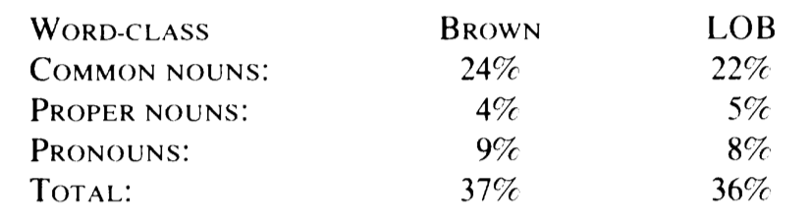
Case study 2: 37% nouns?
Hudson (1994) made the controverisal claim that “about 37% of word-tokens are nouns”
supposed to hold in spoken & written English, Swedish, …
main claim is based on Brown and LOB corpora
Methodological criticism by Hardie (2007)
problematic definition of superordinate noun category (includes when, how, why & cardinals, but excludes ordinals)
all differences due to such decisions, tag set, tokenisation, … are highly significant
Notes:
• Hudson, Richard (1994). About {37\%} of word-tokens are nouns. Language, 70(2), 331-339.
• Hardie, Andrew (2007). Part-of-speech ratios in English corpora. International Journal of Corpus Linguistics, 12(1), 55-81.

Slide 7
Case study 2: 37% nouns?
Replicating Hudson's (1994) results
based on Brown and LOB annotated with C7 tags
follow recommendation of Hardie (2007) to define superordinate noun category by high-level C7 tags
here: simple tags SUBST + PRON
Chi-squared test
X2 = 113.97, df = 1
p < 10^{–16} ***
effect size: 0.58% … 0.84%
 | Brown | LOB
nouns | 348,888 | 339,863
words | 1,024,002 | 1,018,631
ratio | 34.07% | 33.36%
Notes:
Richard Hudson

Slide 8
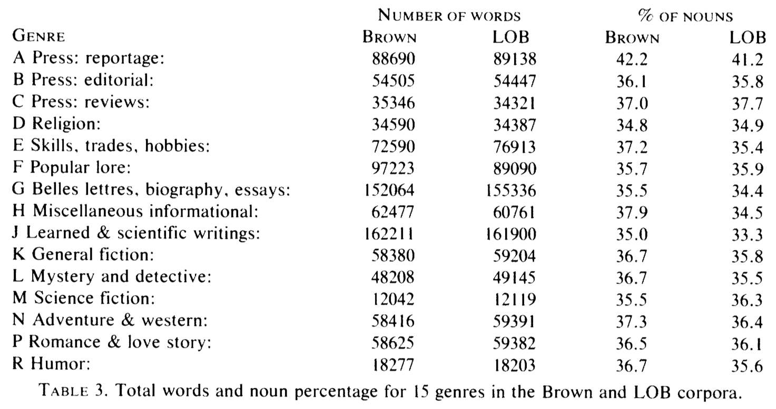
Case study 2: 37% nouns?
Notes:
Can one talk about a noun frequency of 37% if there is language-internal variation between 35% and 42%? (and that is just within edited written genres)
How meaningful is a significant difference between AmE (37%) and BrE (36%) under these circumstances?
How about the significant differences of Hardie (2007)?

Slide 9
Case study 3: Girls, boys and nouns
Rayson et al. (1997) find that men use more common nouns, while women use more pronouns***
based on data from Spoken Demographic component of the British National Corpus (BNC)
superordinate noun category (common/proper nouns + pronouns) also significantly more frequent among females
Notes:
As Hardie (2007) points out, differences in noun frequencies are often used as a metric of variation, e.g. between dialects, registers or speakers – and as we now know also between languages
Lots of explanations come to mind … “male speech is more factual and concerned with reporting information, whereas female speech is more interactive and concerned with establishing and maintaining relationships” (Rayson et al. 1997, p. 139)
Rayson, Paul; Leech, Geoffrey; Hodges, Mary (1997). Social differentiation in the use of English vocabulary: Some analyses of the conversational component of the British National Corpus. International Journal of Corpus Linguistics, 2(1), 133-152.

Slide 10
In a large corpus, everything is***
Compare odd- and even-numbered texts
“Is Odd English different from Even English?”
Noun frequencies in Brown corpus (1960s AmE)
X² = 16.37, df = 1 → p = .000052 < .001***
effect size: 0.20% … 0.56%
Passives in Frown corpus (1990s AmE)
X² = 6.98, df = 1 → p = .0082 < .01**
effect size: 0.13% … 0.87%
(admittedly not significant in other Brown family corpora)

Slide 11

The library metaphor (Evert 2006)
Traditional frequency comparison treats each language variety as a huge library
H₀: same overall proportion of passives / nouns in both varieties
averaged across all sections, with each section weighted by its size
Corpora assumed to be random samples of VP / word tokens!
but in fact they have been sampled at the level of entire books
© David Iliff | CC-by-sa http://commons.wikimedia.org/wiki/File:British_Museum_Reading_Room_Panorama_Feb_2006_edit.jpg
Notes:
Extensional view of language as set of all texts (including hypothetical texts that could have been written or spoken)
Prerequisite for quantitative analysis

Slide 12
Non-randomness in corpus data
Key problem: unit of sampling ≠ unit of measurement
in library metaphor: book vs. token
Data from individual samples are pooled together
Leads to increased sampling variation
random samples follow binomial distribution
but each book contains relatively homogeneous text → co-selection of similar items for sample
Brown is a sample of 500 books, not 100,102 VPs

Slide 13
Pooling data
Illustrate effect of pooling with a thought experiment
Assumption: library with two sections of equal size
e.g. spoken (10% passives) vs. written (40% passives)
overall proportion: π = 25%
Compare true random sample from library
n = 100 tokens sampled invidiually
with lazy sample of two books
50 tokens from each book pooled into sample n = 50 + 50
by plotting the respective sampling distributions

Slide 14
Pooling data
random sample n = 100
pooled data n = 50 + 50

Slide 15
The randomness assumption

Slide 16
The randomness assumption
These texts are significantly different from American English!
Notes:
This is the distribution a chi-squared test assumes to estimate which differences might be due to chance
same for likelihood-ratio, binomial or Fisher's exact test
Each single text would be considered significantly different from AmE if it falls outside the main body of the red curve
Some 40% of the Brown texts would be considered significantly different from AmE → not quite a representative corpus

Slide 17
The randomness assumption

Slide 18
The randomness assumption

Slide 19
The randomness assumption

Slide 20
The randomness assumption

Slide 21
The randomness assumption

Slide 22
The randomness assumption

Slide 23
Student's t-test
Each Brown family corpus is a sample of 500 texts rather than ca. 100,000 individual VP tokens
But more informative measurement for each item: proportion of passives on interval scale
vs. binary passive / active on nominal scale
Suitable hypothesis test: Student's t-test
or non-parametric Mann-Whitney test
Brown | 19.6% | 14.0% | 20.1% | 16.3% | 15.8% | 11.2% | 15.8% | …
LOB | 9.3% | 20.7% | 18.2% | 13.6% | 15.4% | 13.3% | 6.2% | …

Slide 24
Case study 1: t-test
Confirm significance with Student's t-test
H₀: macro-avg. (texts) instead of micro-avg.
Brown vs. LOB:
t = 1.22, df = 997
p = .223 n.s.
Brown vs. Frown:
t = –4.03, df = 991.5
p = .000061 < .001***
effect size: 1.03% … 3.00%
MW: p = .049*
✗ n.s.
Brown: 14.2% micro-avg. 12.6%
LOB: 14.9% micro-avg. 13.3%
δ> 1.03%***
MW: p = .090 n.s.
δ> 0.18%*
Frown: 11.6% micro-avg. 10.4%
FLOB: 13.7% micro-avg. 12.3%
δ> 1.45%***

Slide 25
Case study 2: t-test
Comparison between Odd and Even English
t = 1.31, df = 491.4
p = .19 n.s.
Mann-Whitney test: p = .178 n.s.

Slide 26
End of story?
Are we done now that Odd and Even English are no longer significantly different?
Problem: t-test and Mann-Whitney disagree on two out of four cases
And there's still the troublesome notion of an “average corpus frequency”

Slide 27
Is corpus frequency meaningful?

Slide 28
Is corpus frequency meaningful?

Slide 29
Is corpus frequency meaningful?

Slide 30
Is corpus frequency meaningful?

Slide 31
Modelling linguistic variation
Quantitative analysis must account for the variability of relative frequencies between texts (Gries 2006)
The contrast of interest is one possible factor behind this variation → can be tested for significance
I propose that (linear) statistical models are the appropriate statistical tool for such an approach

Slide 32
Modelling linguistic variation
Linear model predicts relative frequency in each text based on variety, genre, and other factors
goodness-of-fit = R² = proportion of explained variance
grand mean
effect of genre differences
relative frequency in text i
unexplained residuals (binomial sampling + other factors)

Slide 33
LM analysis: Case study 1

Slide 34
LM analysis: Case study 1

Slide 35
LM analysis: Case study 1

Slide 36
LM analysis: Case study 1

Slide 37
Analysis of variance
Df Sum Sq Expl. Var F value Pr(>F)
genre 14 44951 46.72% 61.6131 <2e-16 ***
region 1 140 0.14% 2.6923 0.1012
genre:region 14 565 0.58% 0.7743 0.6980
Residuals 970 50548 52.54%
AmE / BrE has no significant effect
also no evidence for genre-specific differences
But does this model really explain variation?
52.5% residual variance!

Slide 38
Is the linear model good enough?
Lower bound: binomial sampling variation
cannot be avoided when sampling entire texts
same e.g. when recording 10 minutes of speech
Simulation experiment: binomial variation accounts for ca. 6500 variance units → partial R² = 6.5%
Need more explanatory factors = metadata
not available for Brown family (and many other corpora)

Slide 39
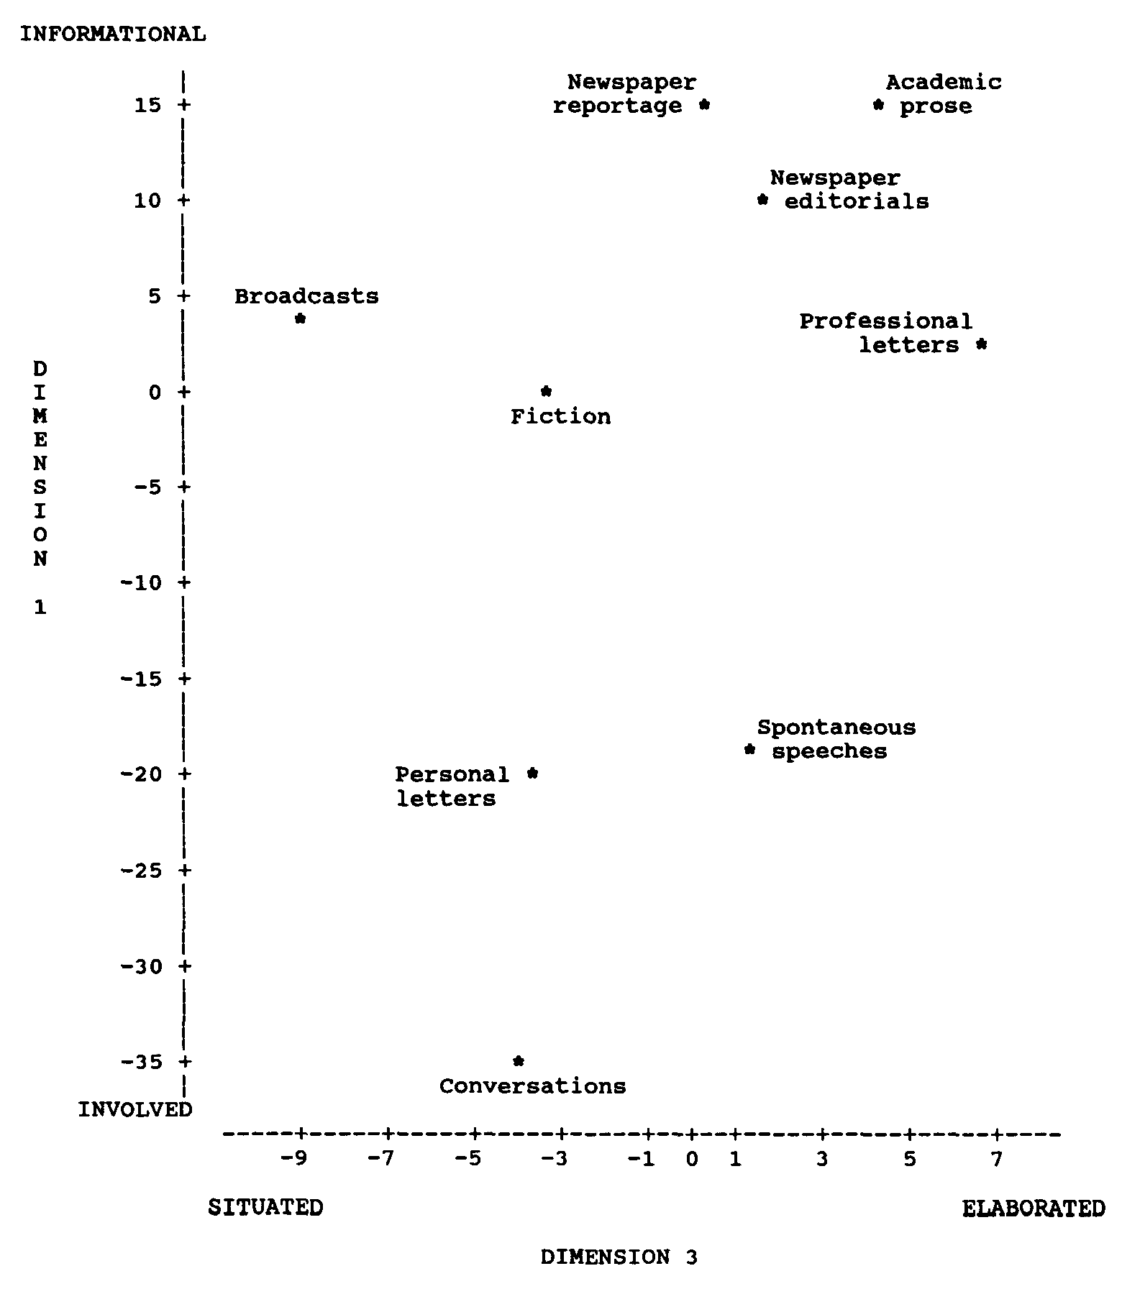
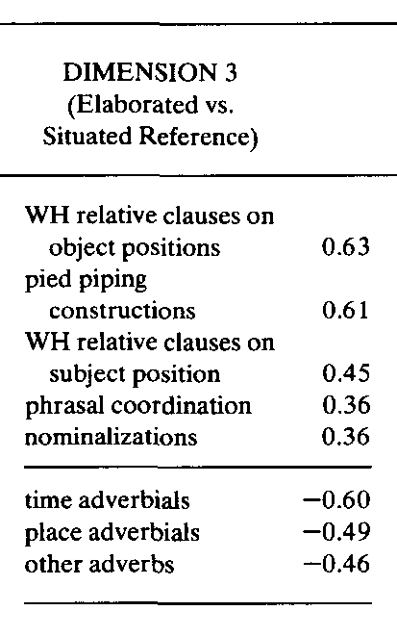
Latent register dimensions
Biber (1993) identifies latent register dim's from correlations btw. linguistic features
Factor analysis / PCA
Use register dimensions as predictive factors in linear model analysis

Slide 40
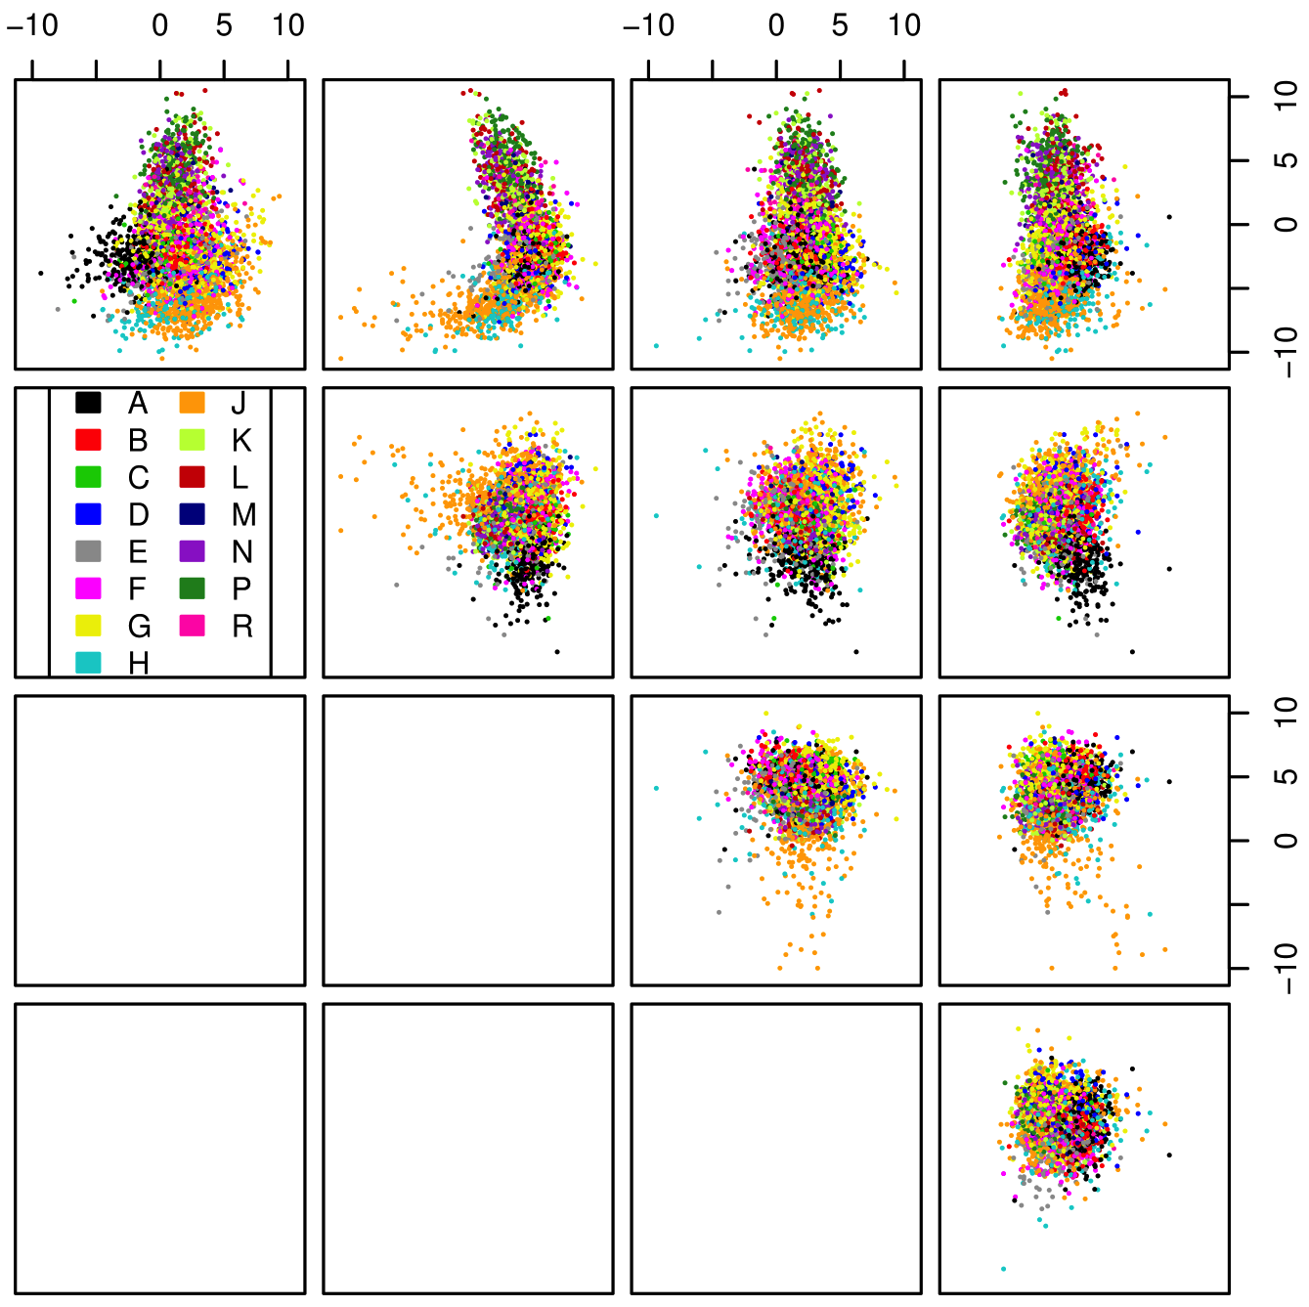
Latent register dimensions
Simplified approach: latent registers based on POS frequency profiles (C7 tags)
Exclude all verb tags to avoid circularity
PCA on standardised frequency counts
First 10 latent dim's considered as factors in LM model

Slide 41
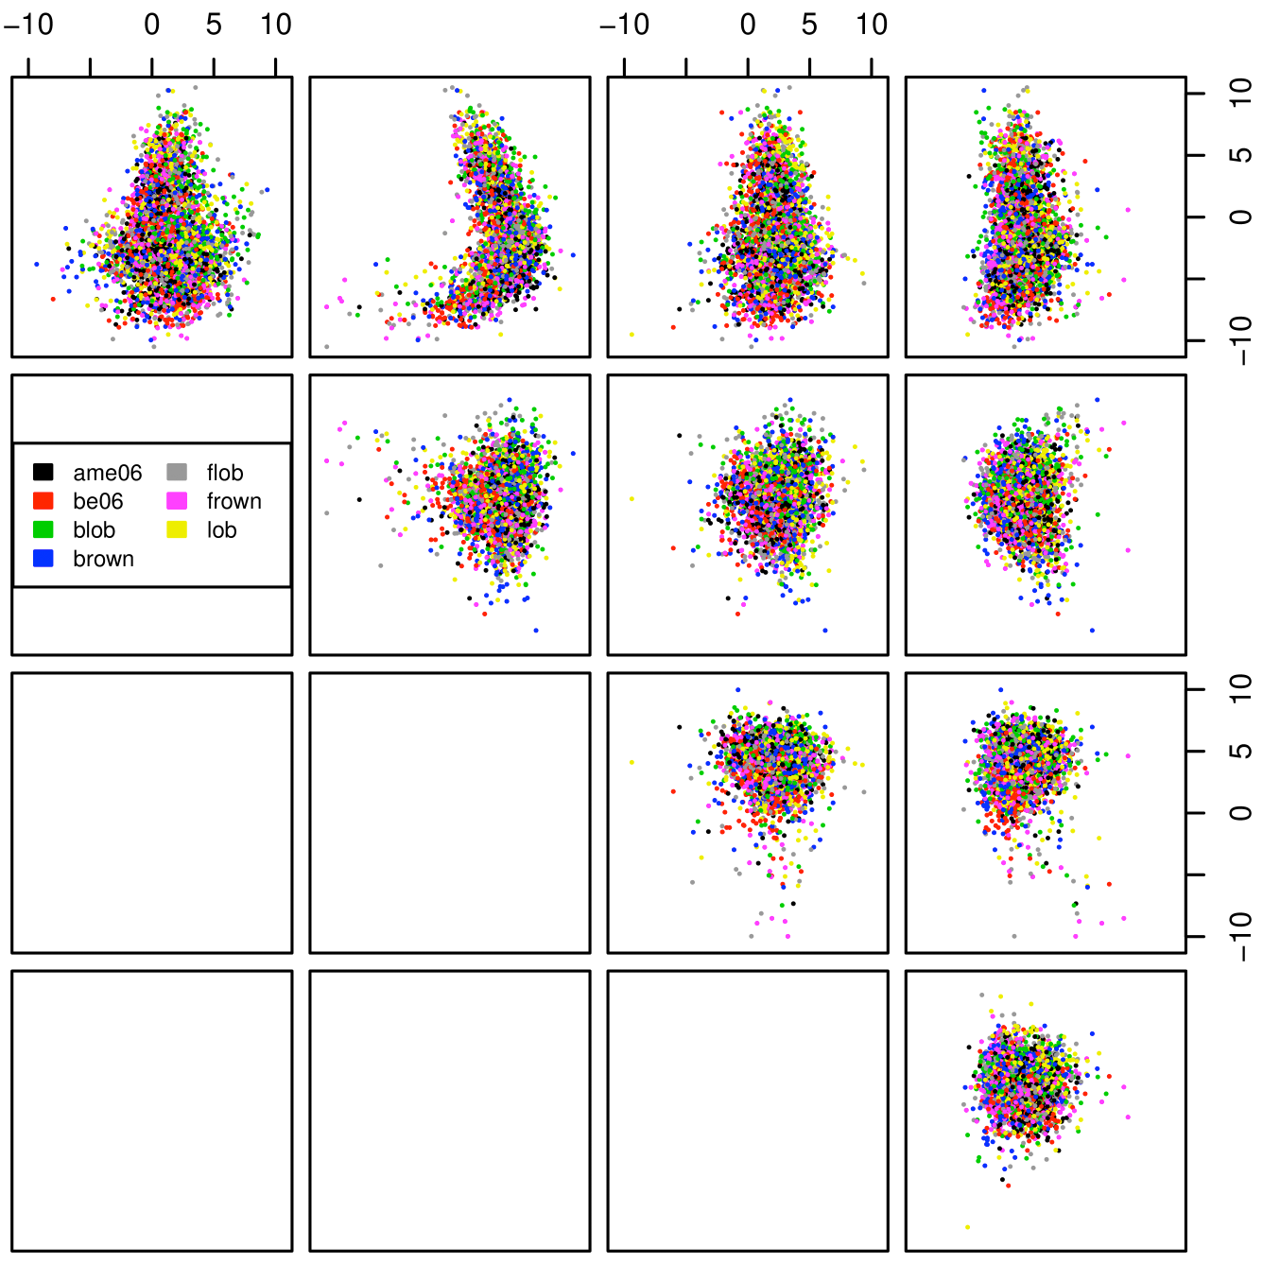
Latent register dimensions
Simplified approach: latent registers based on POS frequency profiles (C7 tags)
Exclude all verb tags to avoid circularity
PCA on standardised frequency counts
First 10 latent dim's considered as factors in LM

Slide 42
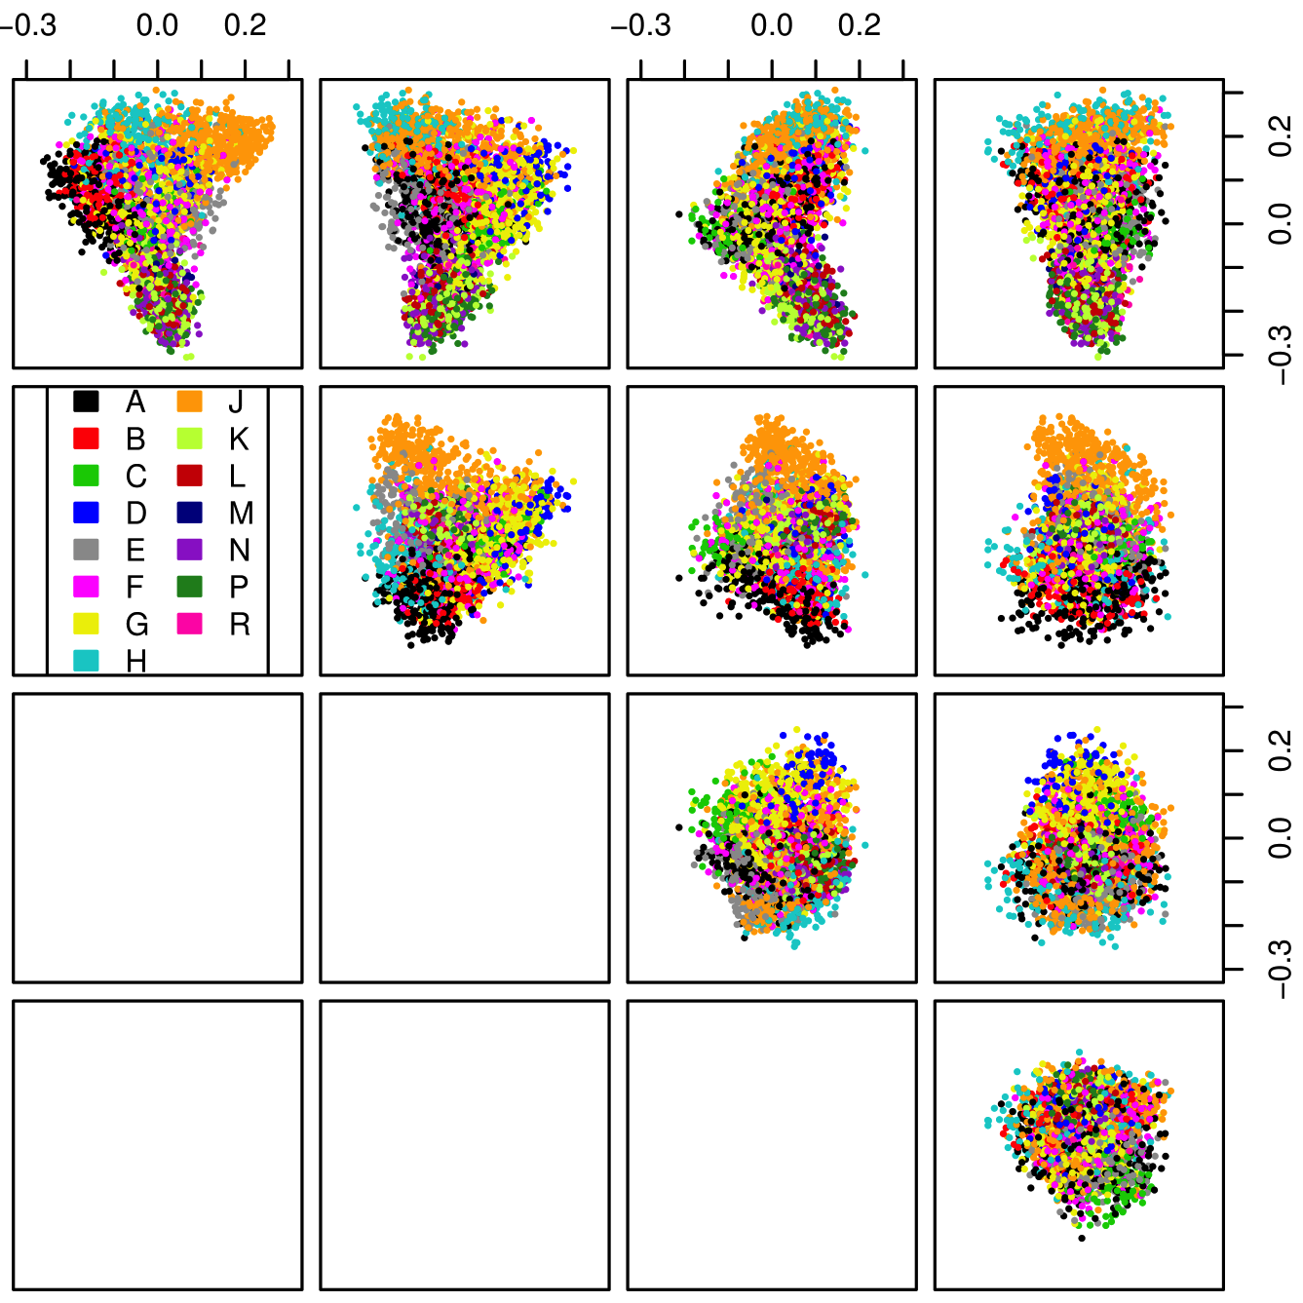
Latent topic dimensions
Distributional semantic models infer meaning of words and texts from distribution of lexical words
Latent Semantic Indexing = SVD of term-document matrix (Deerwester et al. 1990)
First 10 topic dim's as LM factors

Slide 43
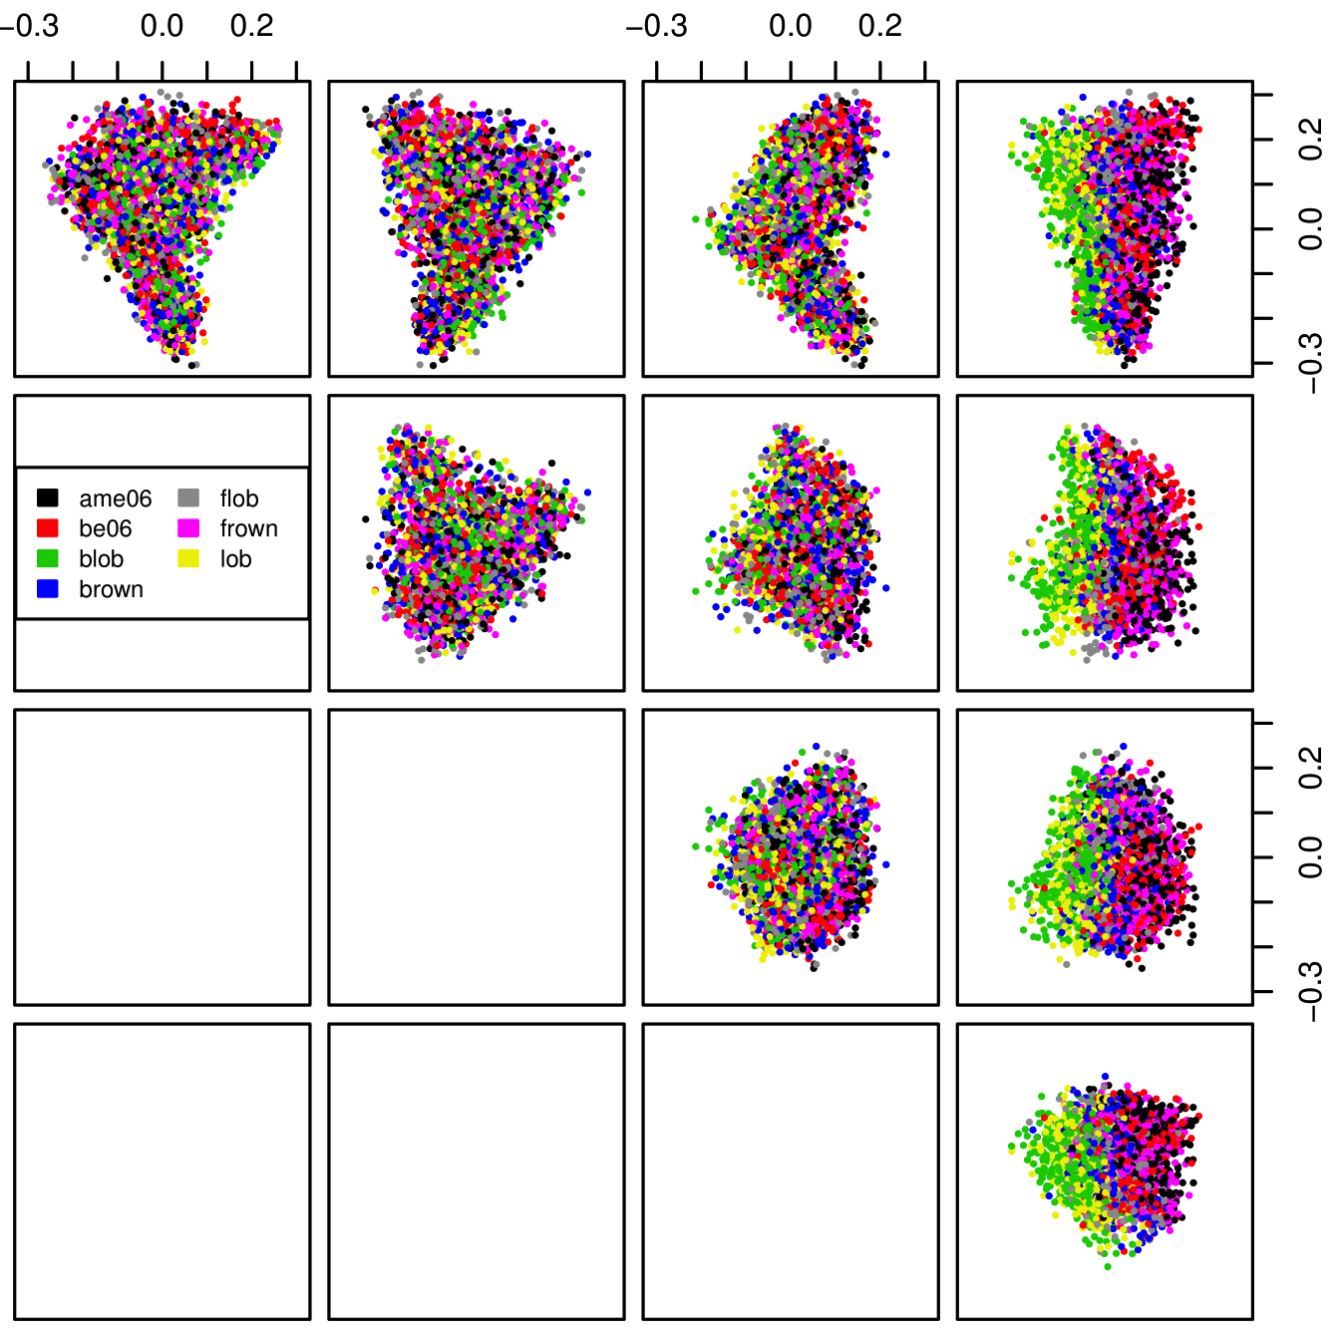
Latent topic dimensions
must exclude topic dim #6
Distributional semantic models infer meaning of words and texts from distribution of lexical words
Latent Semantic Indexing = SVD of term-document matrix (Deerwester et al. 1990)
First 10 topic dim's as LM factors

Slide 44
LM analysis: Case study 1

Slide 45
LM analysis: Case study 1

Slide 46
LM analysis: Case study 1

Slide 47
Interpretation: Case study 1
Df Sum Sq Expl. Var F value Pr(>F)
genre 14 44951 46.72% 125.2242 < 2.2e-16 ***
reg1 1 15425 16.03% 601.6077 < 2.2e-16 ***
reg3 1 4262 4.43% 166.2120 < 2.2e-16 ***
reg5 1 171 0.17% 6.6538 0.01004 *
reg6 1 1076 1.11% 41.9841 1.459e-10 ***
top2 1 118 0.12% 4.5965 0.03228 *
top4 1 1129 1.17% 44.0381 5.337e-11 ***
top5 1 742 0.77% 28.9237 9.428e-08 ***
top8 1 1191 1.24% 46.4364 1.656e-11 ***
top9 1 754 0.78% 29.4211 7.348e-08 ***
top10 1 3 0.00% 0.1349 0.71352
region 1 1409 1.47% 54.9514 2.680e-13 ***
Residuals 974 24973 25.96%
AmE / BrE is highly significant now!
Visual interpretation with partial effects plots

Slide 48
Interpretation: Case study 1
difference:
2.07% … 3.56%

Slide 49
Interpretation: Case study 1

Slide 50
Interpretation: Case study 1

Slide 51
LM analysis: Case study 2

Slide 52
LM analysis: Case study 2

Slide 53
LM analysis: Case study 2

Slide 54
LM analysis: Case study 2

Slide 55
LM analysis: Case study 2

Slide 56
Interpretation: Case study 2
Df Sum Sq Expl. Var F value Pr(>F)
genre 14 3191.3 31.97% 51.8878 < 2.2e-16 ***
top1 1 53.1 0.53% 12.0830 0.0005313 ***
top2 1 355.0 3.56% 80.8065 < 2.2e-16 ***
top3 1 1055.8 10.58% 240.3276 < 2.2e-16 ***
top4 1 71.7 0.72% 16.3129 5.792e-05 ***
top5 1 550.8 5.52% 125.3690 < 2.2e-16 ***
top7 1 71.7 0.72% 16.3236 5.760e-05 ***
top9 1 78.9 0.79% 17.9593 2.471e-05 ***
region 1 186.2 1.87% 42.3873 1.197e-10 ***
top2:region 1 58.2 0.58% 13.2369 0.0002889 ***
top3:region 1 17.6 0.18% 4.0121 0.0454523 *
top5:region 1 14.6 0.15% 3.3182 0.0688217 .
Residuals 974 4279.0 42.86%
Binomial variation: R² = 10% (ca. 1100 variance units)

Slide 57
Interpretation: Case study 2

Slide 58
Interpretation: Case study 2

Slide 59
Interpretation: Case study 2

Slide 60
LM diagnostics: Case study 2
suggests non-linearity (→ include in LM formula)

Slide 61
LM diagnostics: Case study 1
residuals follow heavy-tailed distribution (non-Gaussian)
residuals depend on predicted values (in non-linear fashion)

Slide 62
Limitations of LM
Linear models are not appropriate for the analysis of corpus frequency data because of
normality assumption
residuals must be independent with Gaussian distribution
homoscedasticity
variance constant across all residuals
in particular, must not depend on predicted value
predictions not restricted to range 0% … 100%

Slide 63
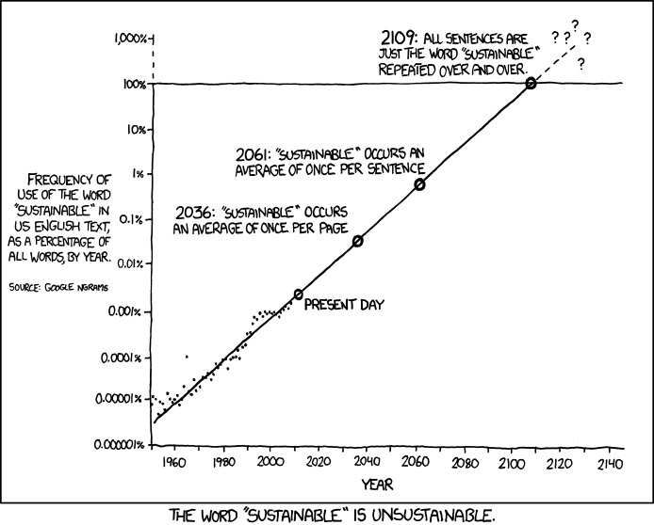
Limitations of LM
© Randall Munroe | CC-by-nc http://xkcd.com/1007/

Slide 64
Generalised linear models (GLM)
Solution: generalised linear models (GLM)
logit link transforms linear predictor into probability
explicitly includes binomial sampling variation
goodness-of-fit: pseudo-R² (e.g. Nagelkerke 1991)
sampling family
link function

Slide 65
Related work
Dispersion and adjusted frequency counts (Gries 2008)
but such heuristic adjustments thwart statistical analysis
Logistic regression models (e.g. Gries 2010, §3.2.2; Bresnan et al. 2007)
token-level predictions of choice vs. text-level prediction of frequency
logistic regression ignores sampling unit = text!

Slide 66
Epilogue: Case study 3
Replication of Rayson et al. (2007)
 | males | females | X2 | p-value
all nouns | 29.83% 372,338 / 1,248,063 | 30.58% 647,451 / 2,117,315 | 206.65 | < 10^{–16} ***
pronouns | 17.44% 217,721 / 1,248,063 | 18.77% 397,386 / 2,117,315 | 920.99 | < 10^{–16} ***
Notes:
As Hardie (2007) points out, differences in noun frequencies are often used as a metric of variation, e.g. between dialects, registers or speakers – and as we now know also between languages
Lots of explanations come to mind … “male speech is more factual and concerned with reporting information, whereas female speech is more interactive and concerned with establishing and maintaining relationships” (Rayson et al. 1997, p. 139)

Slide 67
Epilogue: Case study 3
Unit of measurement: word token
Sampling unit: speaker
Student's t-test on relative frequency per speaker
all nouns: t = –0.35, df = 683.2 → p = .727 n.s.
pronouns: t = 3.37, df = 702.3 → p = .00078 < .001*** effect size: female > male by at least 0.37%
Linear model based on sex, age group, region and other speaker metadata is not informative
Notes:
As Hardie (2007) points out, differences in noun frequencies are often used as a metric of variation, e.g. between dialects, registers or speakers – and as we now know also between languages
Lots of explanations come to mind … “male speech is more factual and concerned with reporting information, whereas female speech is more interactive and concerned with establishing and maintaining relationships” (Rayson et al. 1997, p. 139)

Slide 68
Thank YoU

Slide 69
References 1
Biber, Douglas (1993). Using register-diversified corpora for general language studies. Computational Linguistics, 19(2), 219–241.
Bresnan, Joan; Cueni, Anna; Nikitina, Tatiana; Baayen, R. Harald (2007). Predicting the dative alternation. In G. Boume, I. Kraemer, and J. Zwarts (eds.), Cognitive Foundations of Interpretation, pages 69–94. Royal Netherlands Academy of Science, Amsterdam, Netherlands.
Church, Kenneth W. (2000). Empirical estimates of adaptation: The chance of two Noriegas is closer to p/2 than p2. In Proceedings of COLING 2000, pages 173–179, Saarbrücken, Germany.
Deerwester, Scott; Dumais, Susan T.; Furnas, George W.; Landauer, Thomas K.; Harshman, Richard (1990). Indexing by latent semantic analysis. Journal of the American Society For Information Science, 41(6), 391– 407.
Evert, Stefan (2006). How random is a corpus? The library metaphor. Zeitschrift für Anglistik und Amerikanistik, 54(2), 177–190.

Slide 70
References 2
Gries, Stefan Th. (2006). Exploring variability within and between corpora: some methodological considerations. Corpora, 1(2), 109–151.
Gries, Stefan Th. (2008). Dispersions and adjusted frequencies in corpora. International Journal of Corpus Linguistics, 13(4), 403–437.
Gries, Stefan Th. (2010). Useful statistics for corpus linguistics. In A. Sánchez and A. Moiśes (eds.), A Mosaic of Corpus Linguistics: Selected Approaches, pages 269–291. Peter Lang, Frankfurt am Main.
Hardie, Andrew (2007). Part-of-speech ratios in English corpora. International Journal of Corpus Linguistics, 12(1), 55–81.
Hudson, Richard (1994). About 37% of word-tokens are nouns. Language, 70(2), 331–339.
Katz, Slava M. (1996). Distribution of content words and phrases in text and language modelling. Natural Language Engineering, 2(2), 15–59.
Kilgarriff, Adam (2005). Language is never, ever, ever, random. Corpus Linguistics and Linguistic Theory, 1(2), 263–276.

Slide 71
References 3
Leech, Geoffrey; Hundt, Marianne; Mair, Christian; Smith, Nicholas (2009). Change in Contemporary English: A Grammatical Study. Studies in English Language. Cambridge University Press, Cambridge.
McEnery, Tony and Wilson, Andrew (2001). Corpus Linguistics. Edinburgh University Press, 2nd edition.
Nagelkerke, N. J. D. (1991). A note on a general definition of the coefficient of determination. Biometrika, 78(3), 691–692.
Rayson, Paul; Leech, Geoffrey; Hodges, Mary (1997). Social differentiation in the use of English vocabulary: Some analyses of the conversational component of the British National Corpus. International Journal of Corpus Linguistics, 2(1), 133–152.

Slide 72
Outlook
Token-level models → logistic regression
local features influencing e.g. pass/act choice; e.g. intransitivity of verb
repetition effects (“term clustering”) can be modelled as auto-correlated time series (Pipa & Evert 2010)
also for repeating/cyclic patterns
speech rate as predictor of noun/verb ratio
text as sampling unit can be included as random effect (→ precise statistical inference difficult)

